Slide 1
Lesson 6 : Hardhat Simple Storage
Garry Abel Diaraja H - 1103190147

Slide 2
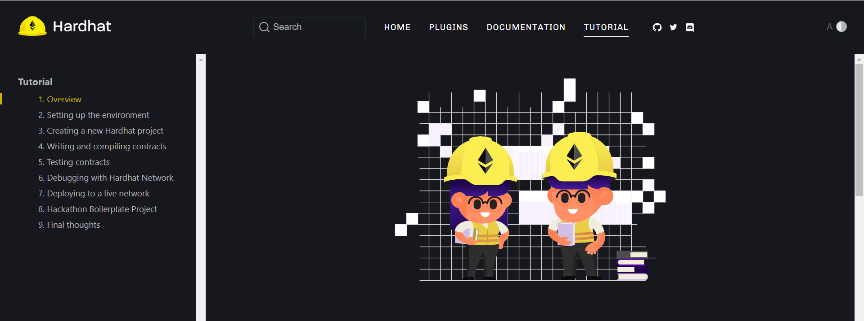
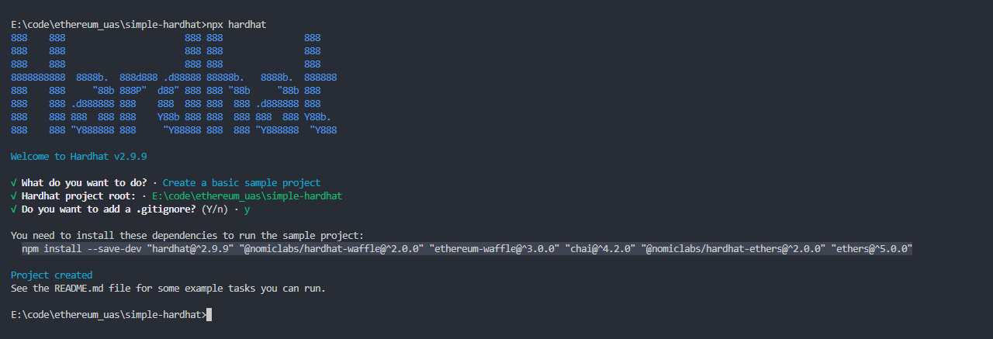
Hardhat Setup
Followed hardhat tutorial (https://hardhat.org/tutorial):

Slide 3
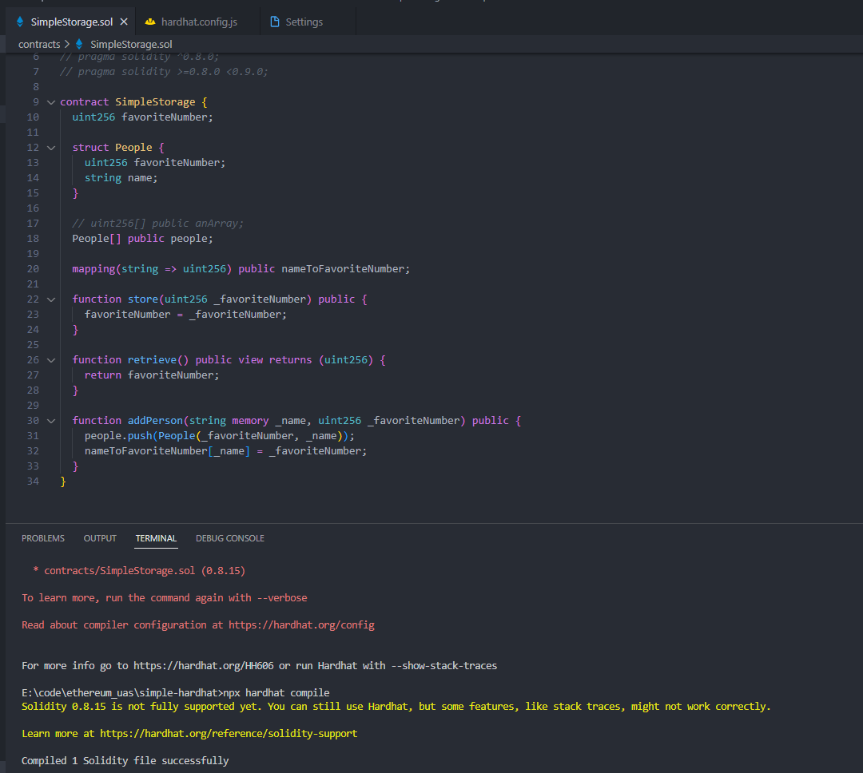
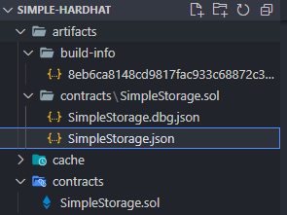
Deploying SimpleStorage from Hardhat
Compiled result:

Slide 4
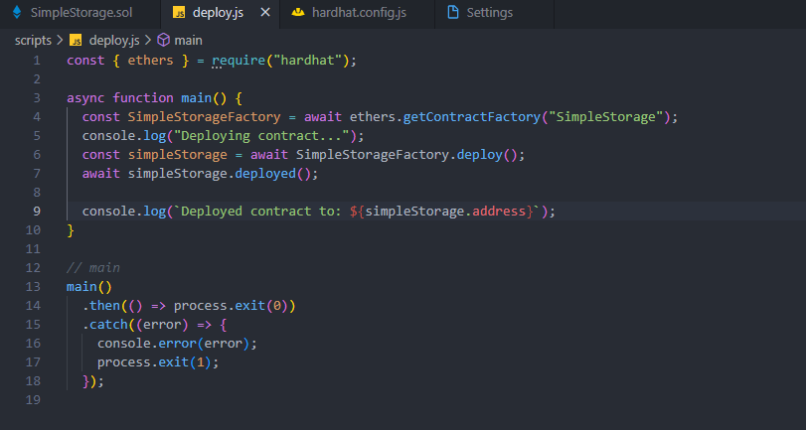


Deploying SimpleStorage from Hardhat (2)
deploy result:

Slide 5
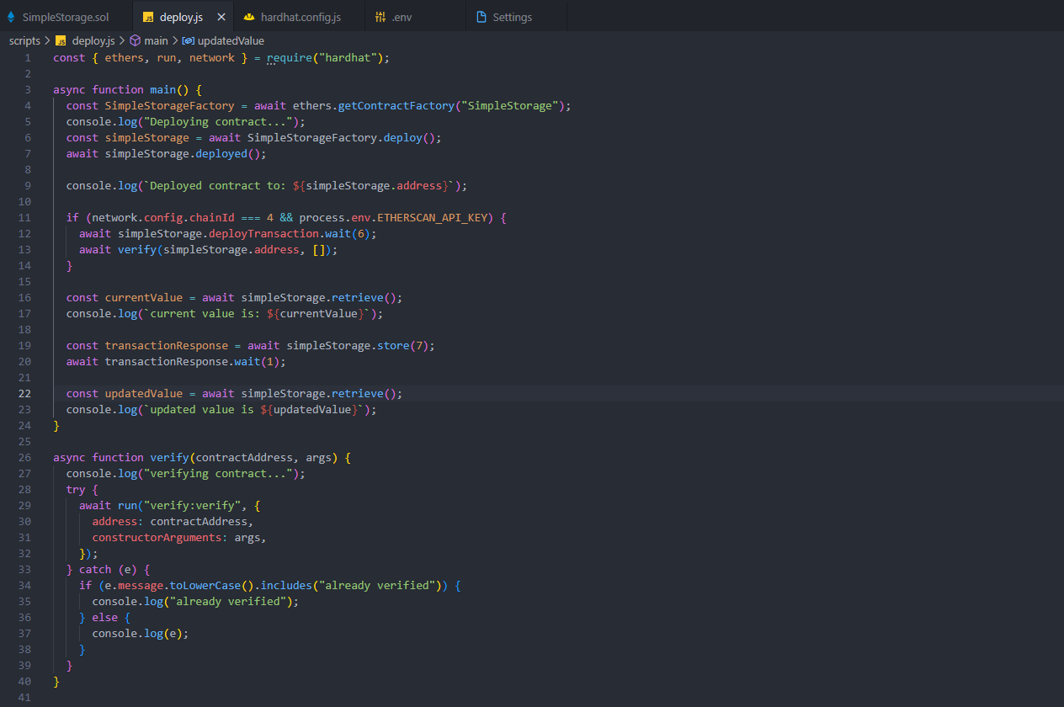
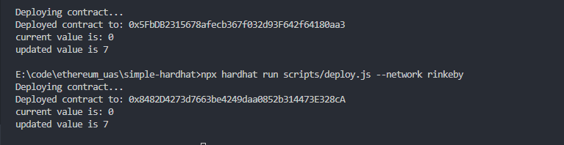
Verifying Contract Programmactically

Slide 6
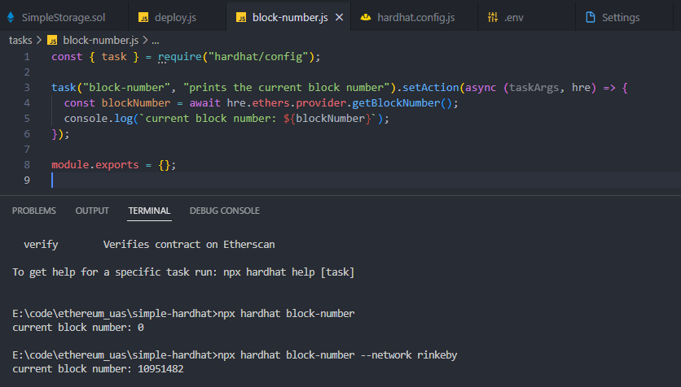
Hardhat Custom Tasks

Slide 7
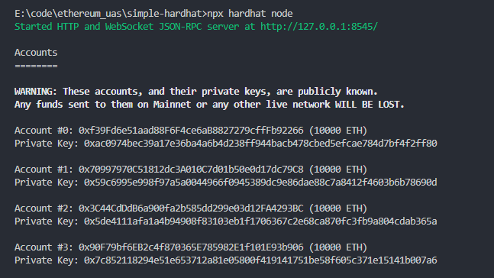
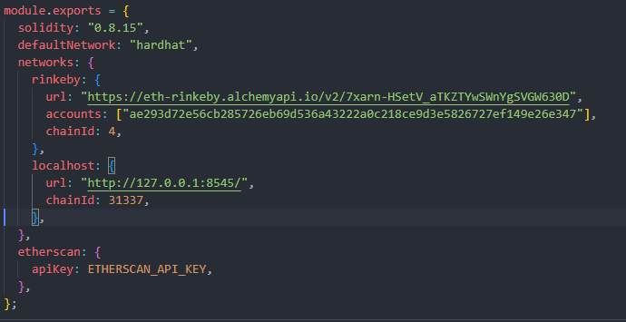
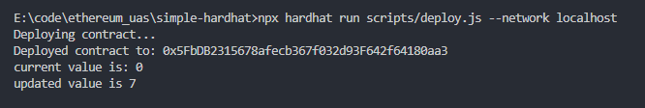
Hardhat Localhost Node
Generated accounts:
Added localhost network config:
Test run:

Slide 8
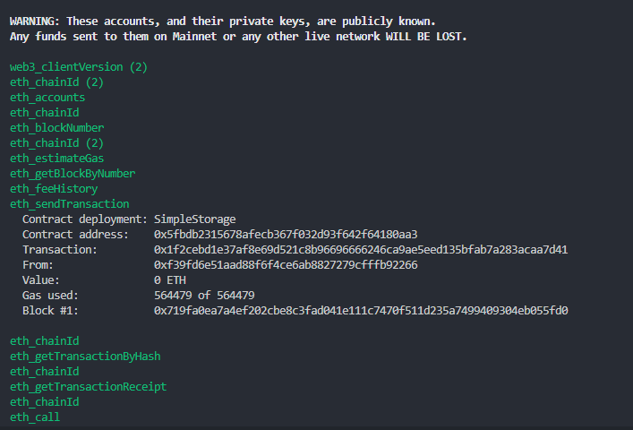
Hardhat Localhost Node (2)
Log results:

Slide 9
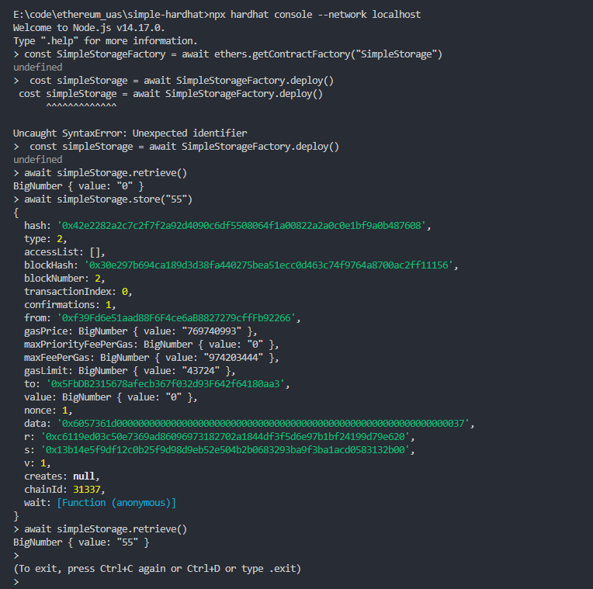
Hardhat Console

